Slide 1

Critical Problem Faced by Customers
Understanding the challenges they encounter
Customers are experiencing significant obstacles that hinder their growth and satisfaction. By addressing these pain points, we can create effective solutions that drive customer success and improve overall experiences.

Slide 2
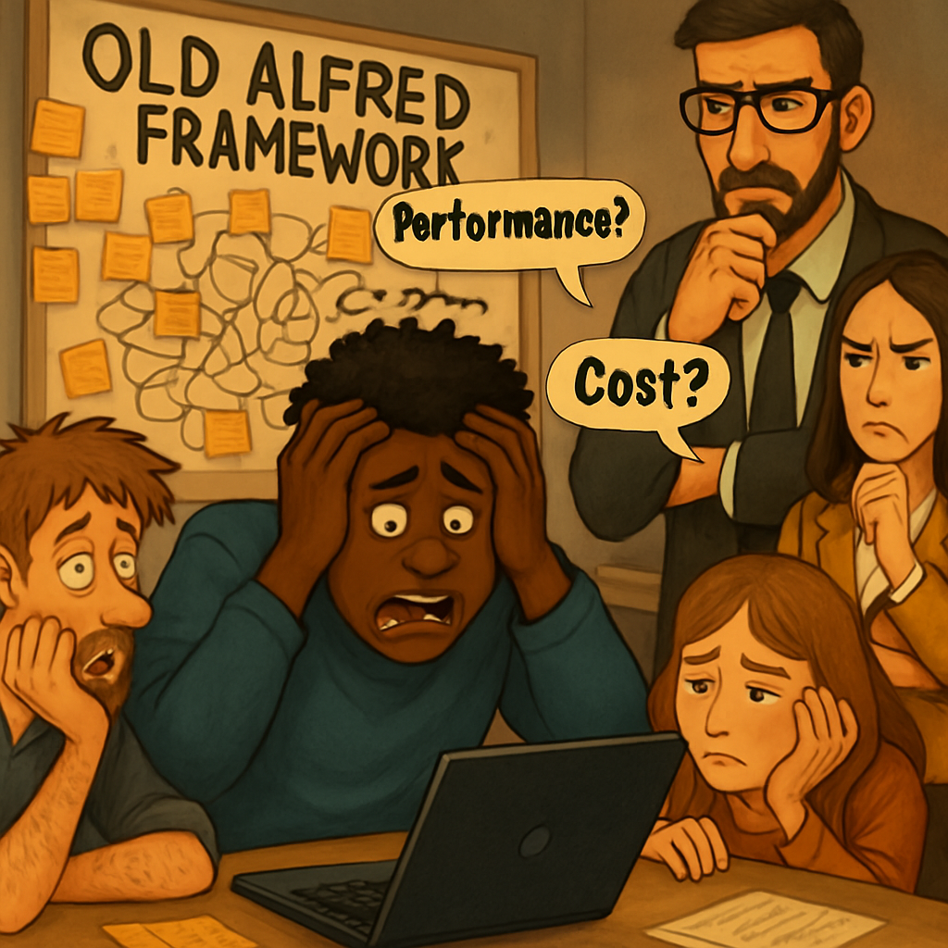
Critical Problem Faced by Customers
Understanding the challenges they encounter
Customers are experiencing significant obstacles that hinder their growth and satisfaction. By addressing these pain points, we can create effective solutions that drive customer success and improve overall experiences.

